Slide 1
Prediction of Product upgrade of freemium/trial users
Midsem Review
Student : Prasanth R(2019hc04979)
Supervisor : Sabari Murugan S
Examiner : Govada Aruna

Slide 2
Introduction
To predict whether a user will likely to upgrade from freemium to premium option.
We propose a prediction model which targets the free licensed users who are very likely to purchase their business licenses.
This prediction is computed with the help of the trained data which contains the user’s application usage data.

Slide 3
Dissertation Project’s Lifecycle:
Data Collection
Data Analysis
Feature Engineering
Feature Selection
Model Building
Model Deployment

Slide 4
Dissertation project subtask status
Task | Status
Data Collection | Completed
Data Analysis | Completed
Feature Engineering | Completed
Feature Selection | Completed
Model Building | Completed
Model Deployment | Completed
Develop Python App to Access prediction as API | Completed

Slide 5
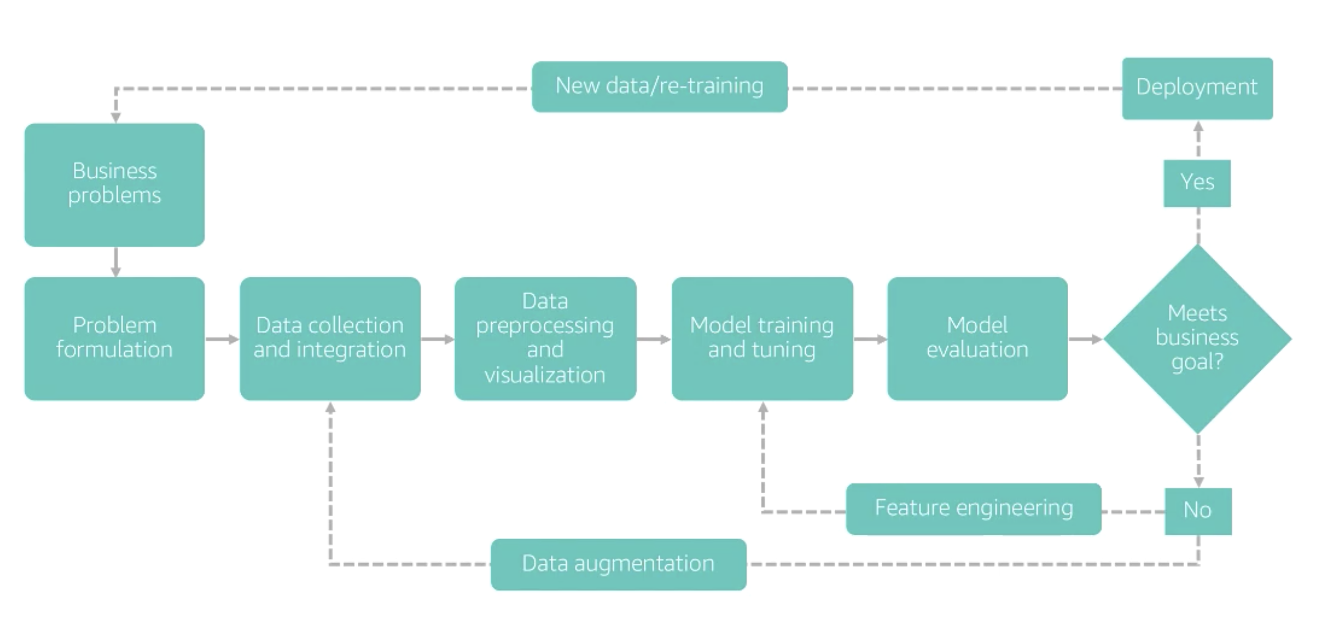
Flowchart

Slide 6
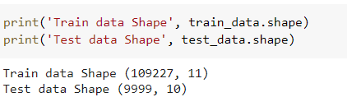
Data Collection
We have collected a real time user data without compromising the data quality at the same time without breaching any data integrity or involving in any form of data violations. The trivial user related(will not be useful for predicts) are excluded and some are mocked.
We have created an application in Java to collect the real data. The collected raw data is not gathered simply by querying the tables there were umpteen transformations and aggregations performed to collect the reliable which provides the pertinent results.
We have collected training data as well as the test based on the real data as part of this dissertation.

Slide 7
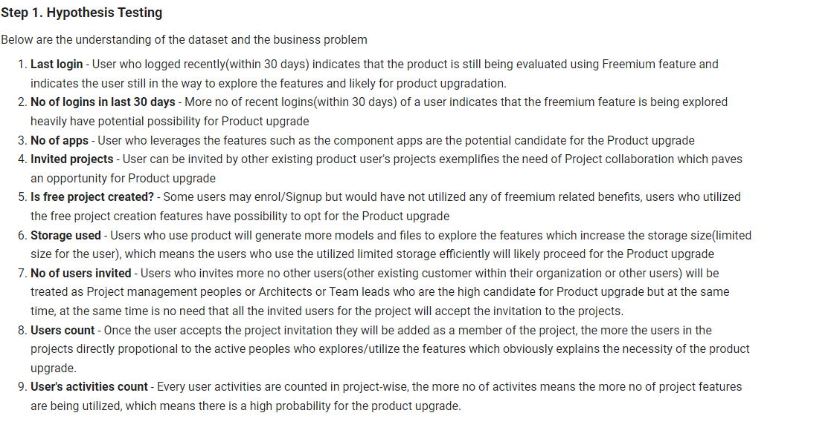
Data Analysis
As a first step hypothesis test were conducted to understanding the dataset and the business problem

Slide 8
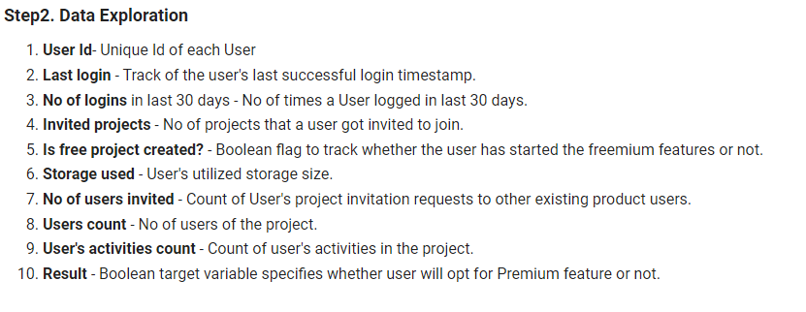
Data Analysis (Continued..)
Details about the the variables gathered in our dataset.

Slide 9
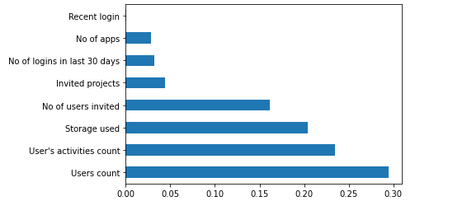
Feature Engineering and Feature Selection
Below task are performed as part of the feature engineering
Handled the missing values, outliers, unbalanced dataset
Data transformation of categorical values to numerical values
Created required features from the existing feature set by applying use case logics
Cleaned the data by dropping unique value, temporal features which helps to create meaningful features
Feature selection is done on top of scalar transformed data and the features are finalized using the ‘feature_selection’ library with feat_importances score

Slide 10
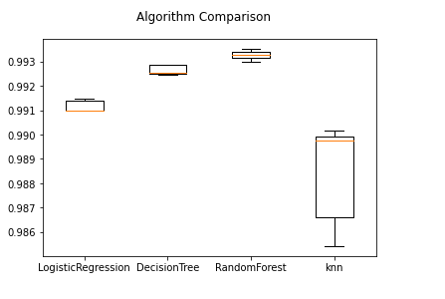
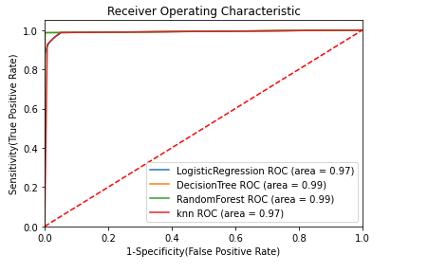
Model Selection
The model is build on top of the finalized features using various techniques.
As the problem statement belongs to classification model related, we started the model building process with the basic “LogisticRegression” algorithm and build the “DecisionTree”, “RandomForest” and “knn” models using the processed dataset.
We compared the classification algorithms based on ROC curve and accuracy score also using k-fold Cross-Validation. Based on the aforementioned result “RandomForest” performed better than other algorithms. Traditional Propensity Ensemble methods for uplift modeling such as “XGBClassifier” will be used to increase the accuracy of the model and for final predictions.

Slide 11
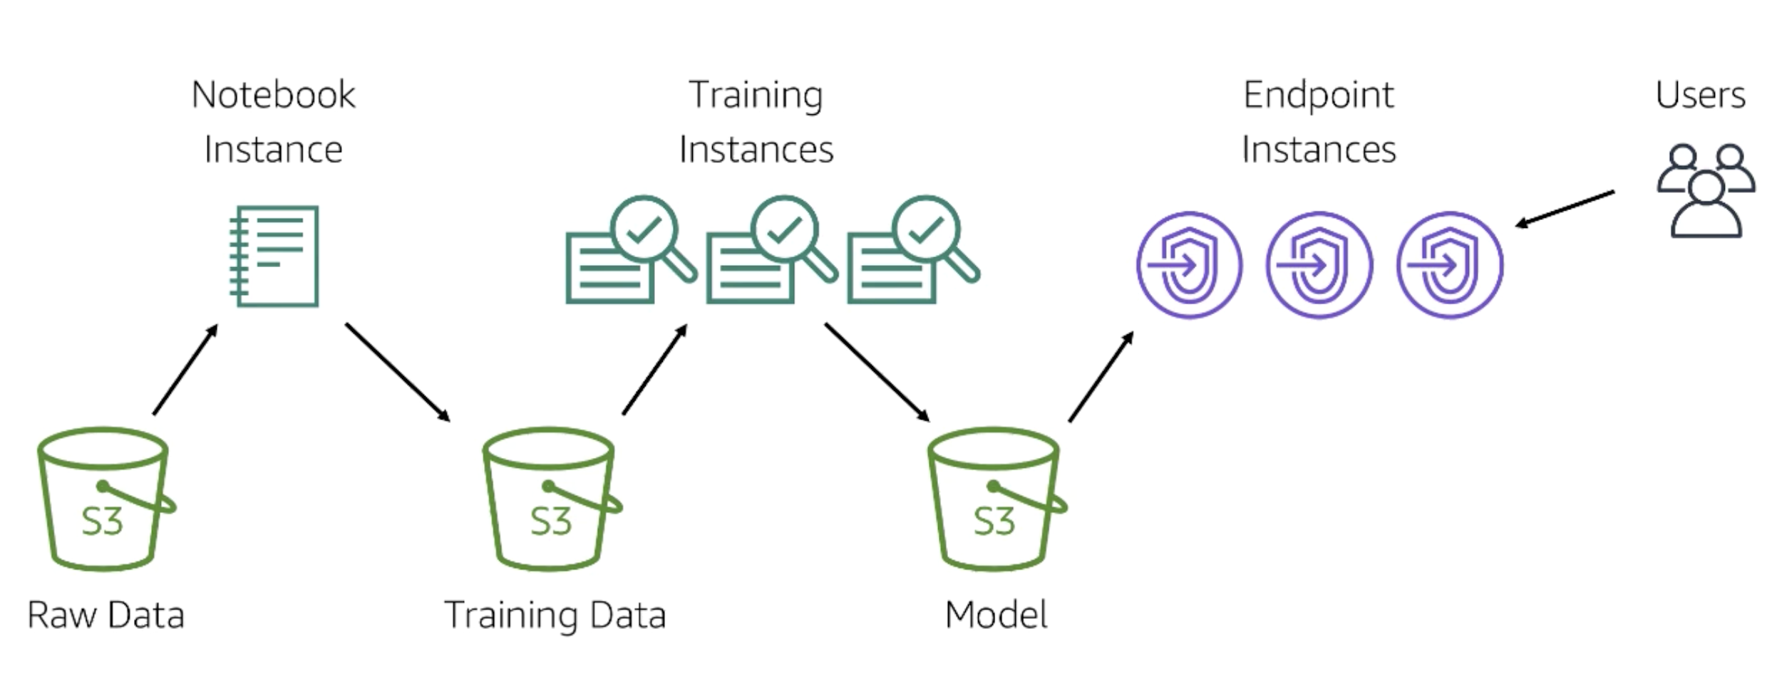
Model Building
We have used AWS Sagemaker which is a Machine Learning end to end service that solves the problem of training, tuning, and deploying Machine Learning models.
It provides us with a Jupyter Notebook instance that runs on a virtual machine hosted by Amazon. We can perform all our data analysis and preprocessing in the notebook along with model development and validation as we do on our local machines. Furthermore, it enables us to deploy our model by creating an API endpoint that can be accessed through any web app to obtain results.
AWS Sagemaker creates endpoint for our model to interact with various applications making use of various additional services provided by AWS, such as Lambda Function & AWS API Gateway Proxy. However here our main aim is to create an endpoint.

Slide 12
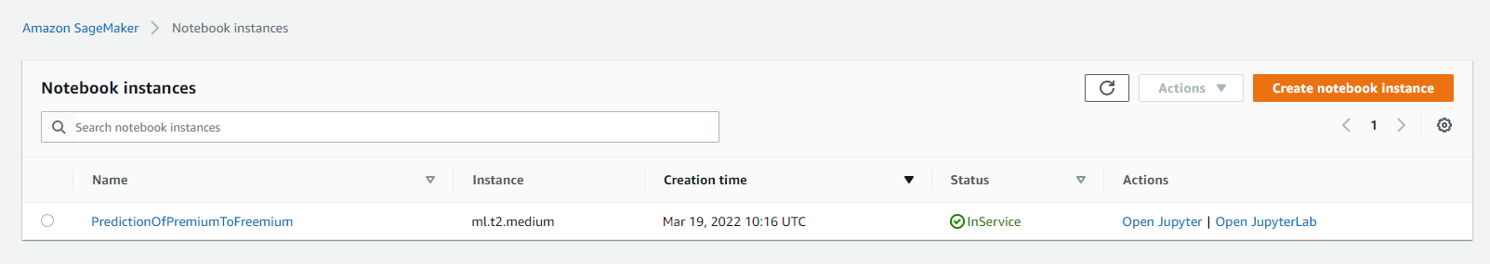
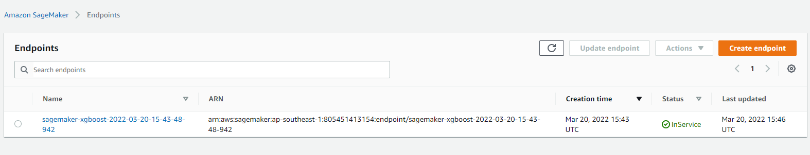
Screenshots of AWS Sagemaker instances
AWS SageMaker notebook instances
AWS SageMaker endpoint

Slide 13
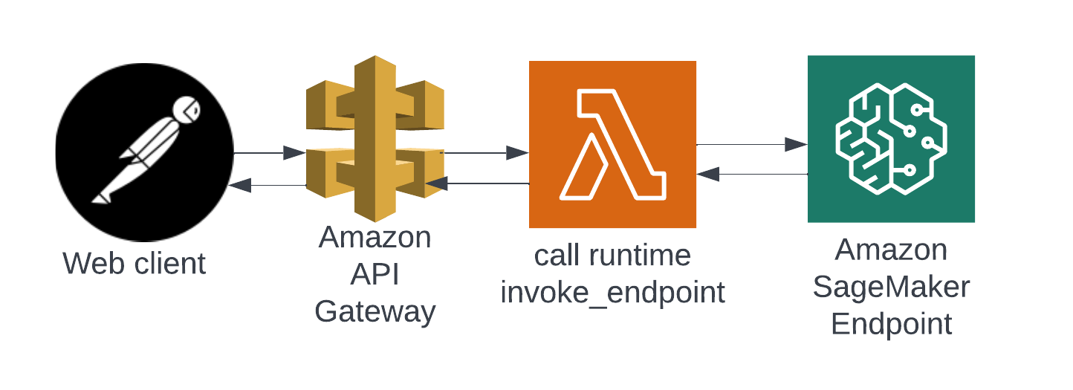
Model Deployment
The ML model is deployed into AWS SageMaker and Amazon SageMaker model provides a feature to access endpoint using http, lambda protocol. As part of this dissertation we are accessing the aws sagemaker endpoint using Amazon API Gateway and AWS Lambda combinations.
We have developed python program which will convert custom json input to pertinent payload format and call the sagemaker endpoint and return the response. The lambda will be invoked by Amazon API Gateway, which is an entry point for url access.

Slide 14
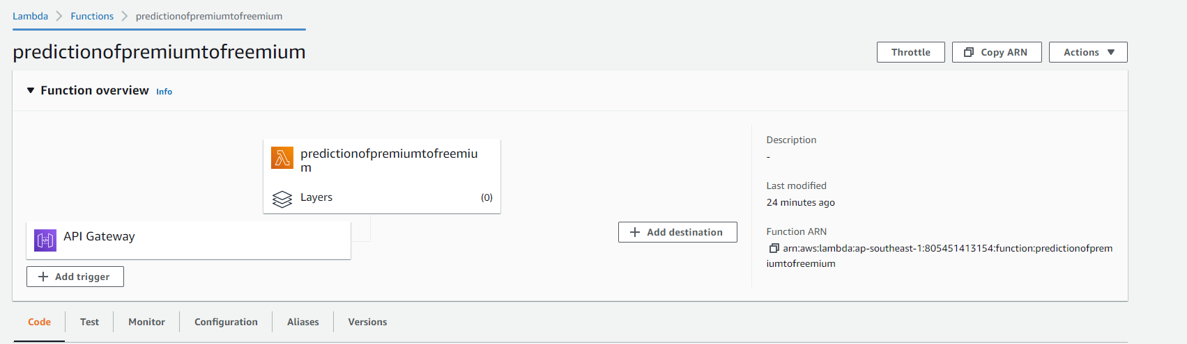
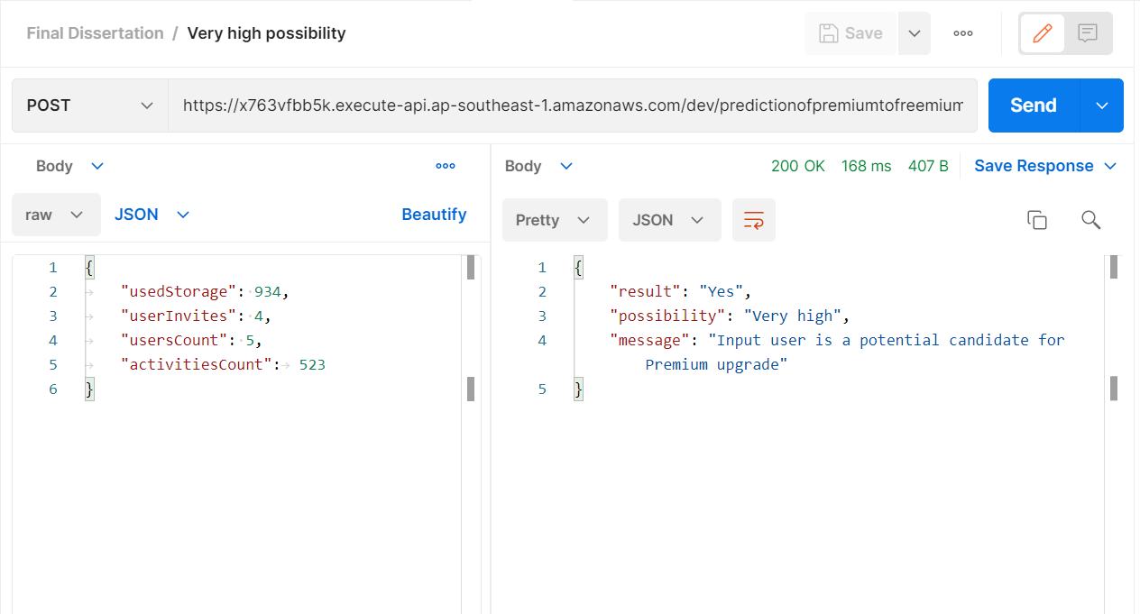
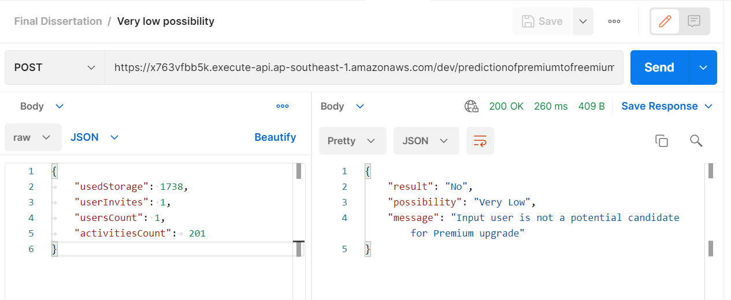
Screenshots of AWS Lambda & Gateway configuration
Success Scenario
Failure Scenario

Slide 15
SIGNIFICANCE
This project monitors and trains the data collected from the usage of application by FREEMIUM users and predicts the potential users who are likely to purchase the Business license.
Using this prediction the users can be given personalized recommendations and offers by sharing information about the perks of being a business licensed user.
This will help the Trimble Connect product team as well as marketing team to target the customers in a more efficient way there by improving the revenue on a higher scale.

Slide 16
TECHNOLOGIES
Jupyter notebook
Google colab
Python
AWS S3, SageMaker, API Gateway, Lambda
Postman

Slide 17
Existing work on related topic
Uniqueness in this dissertation
There is many predicts are being developed and researched in the area of Predicting User churn, Customer retention, Customer satisfaction and uplift modeling.
This particular prediction model is specifically targets the users based on their usage patterns and helps to narrow down the potential premium subscribers of a Saas product using prescriptive techniques

Slide 18
FUTURE PLANS(not in the scope of dissertation)
Improve the prediction algorithm by normalizing to suggest the appropriate license to the user based on their usage.
Use the prediction technique to suggest different apps for users.

